Slide 1
CSC 3210 Computer Organization and Programming
Lab Work 2
Dr. Zulkar Nine
mnine@gsu.edu
Georgia State University
Spring 2021

Slide 2
Lab Work 2 Instructions
Lab 2(a): Run a sample assembly language code (3 points)
Lab 2(b): Math problems (2 points)
Lab 2(c): Registers and Memory related Problems (5 points)
Due Date: 1/29/21 11:59 PM

Slide 3
Lab 2(a)
Run a sample assembly code in Microsoft visual Studio

Slide 4
Lab 2(a) Instructions
Follow the instructions to run the first program in assembly language.
Take screenshot/screenshots showing the code and the register contents.
Submit to the iCollege

Slide 5
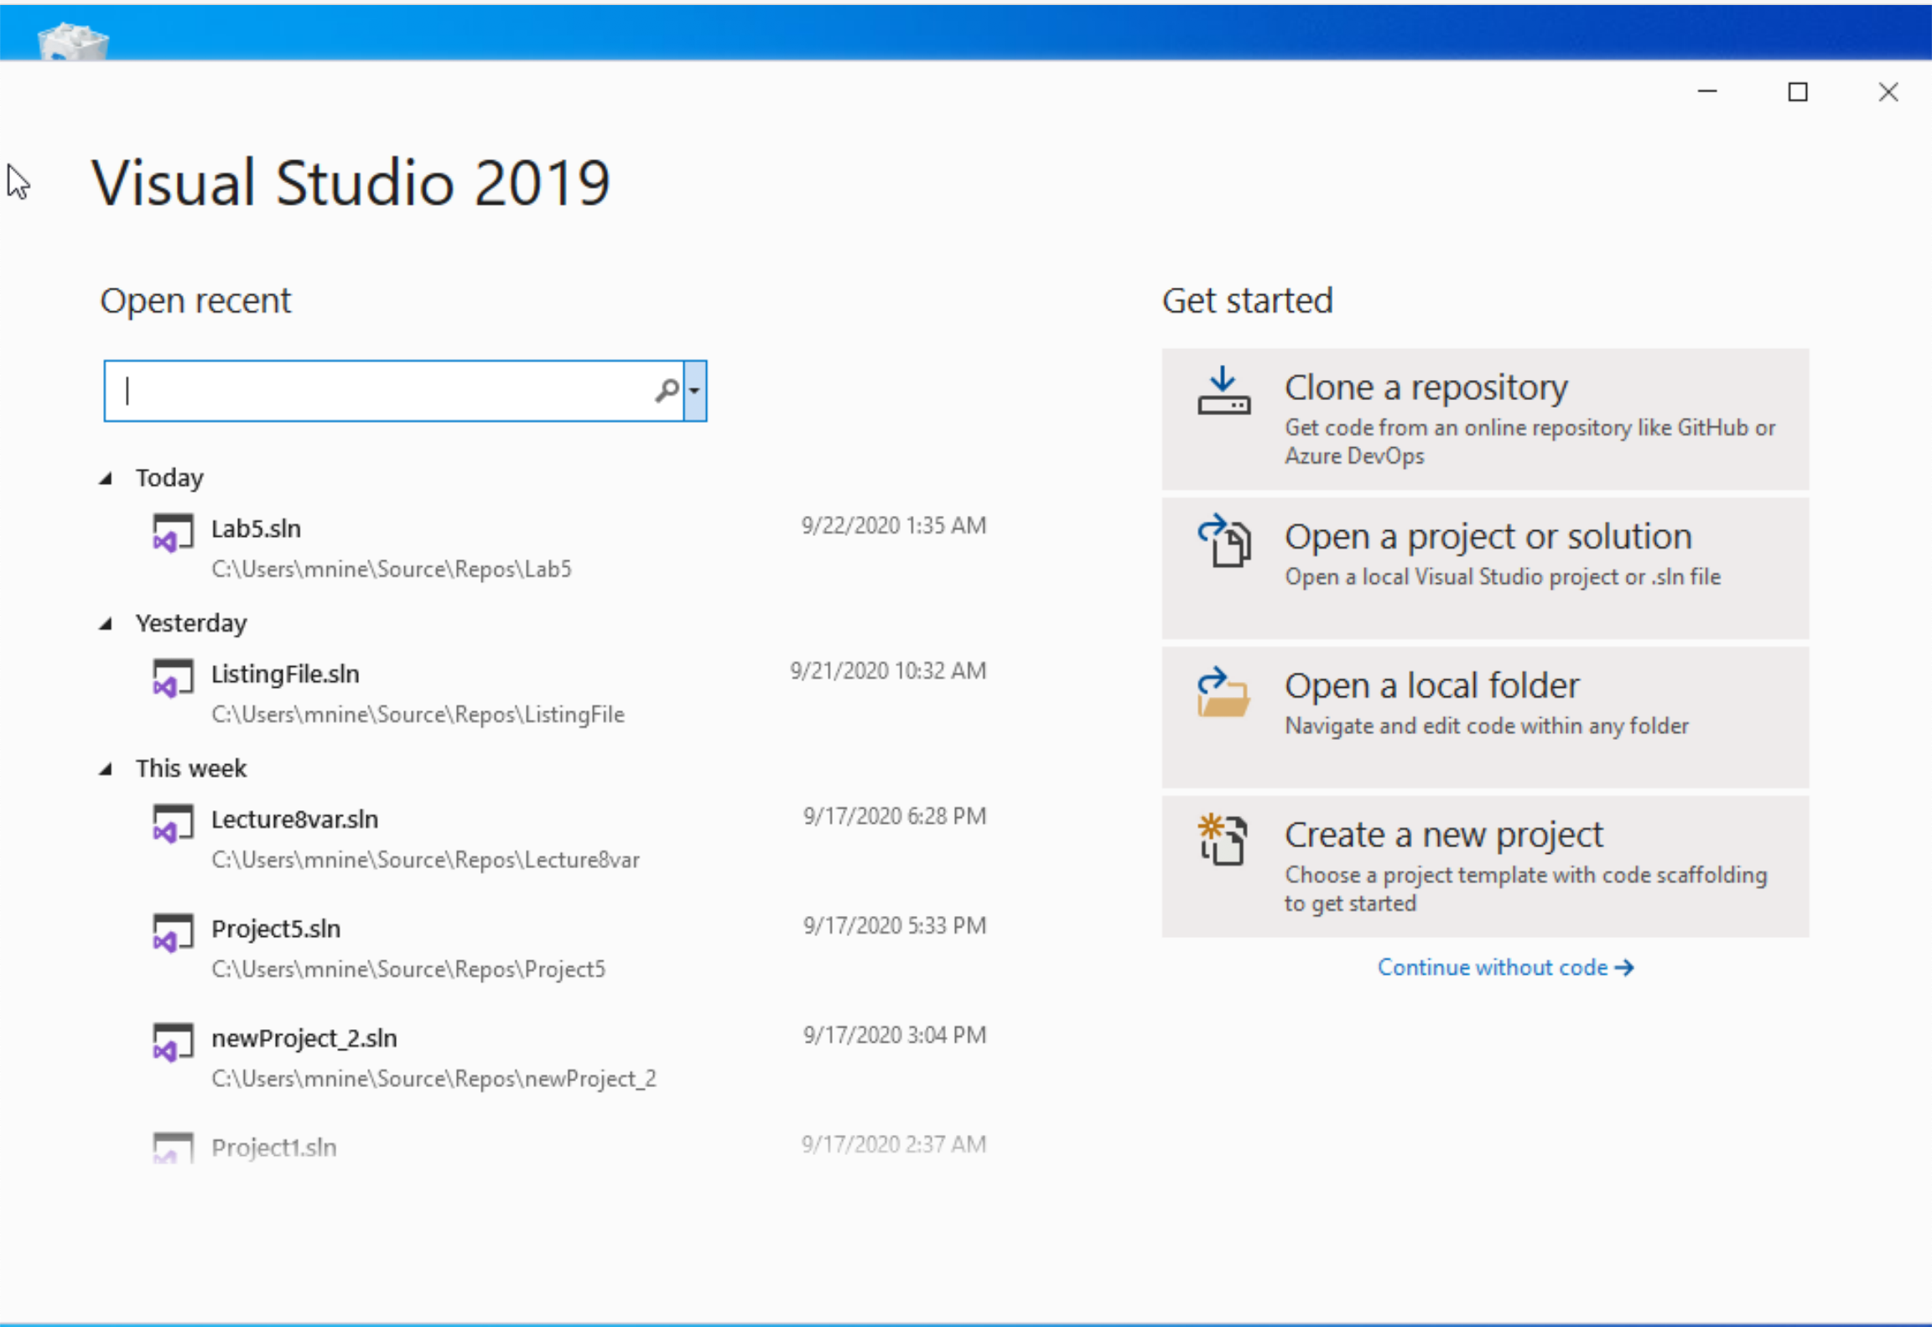


Create a new Project
Start Visual Studio
Click Create a new Project

Slide 6
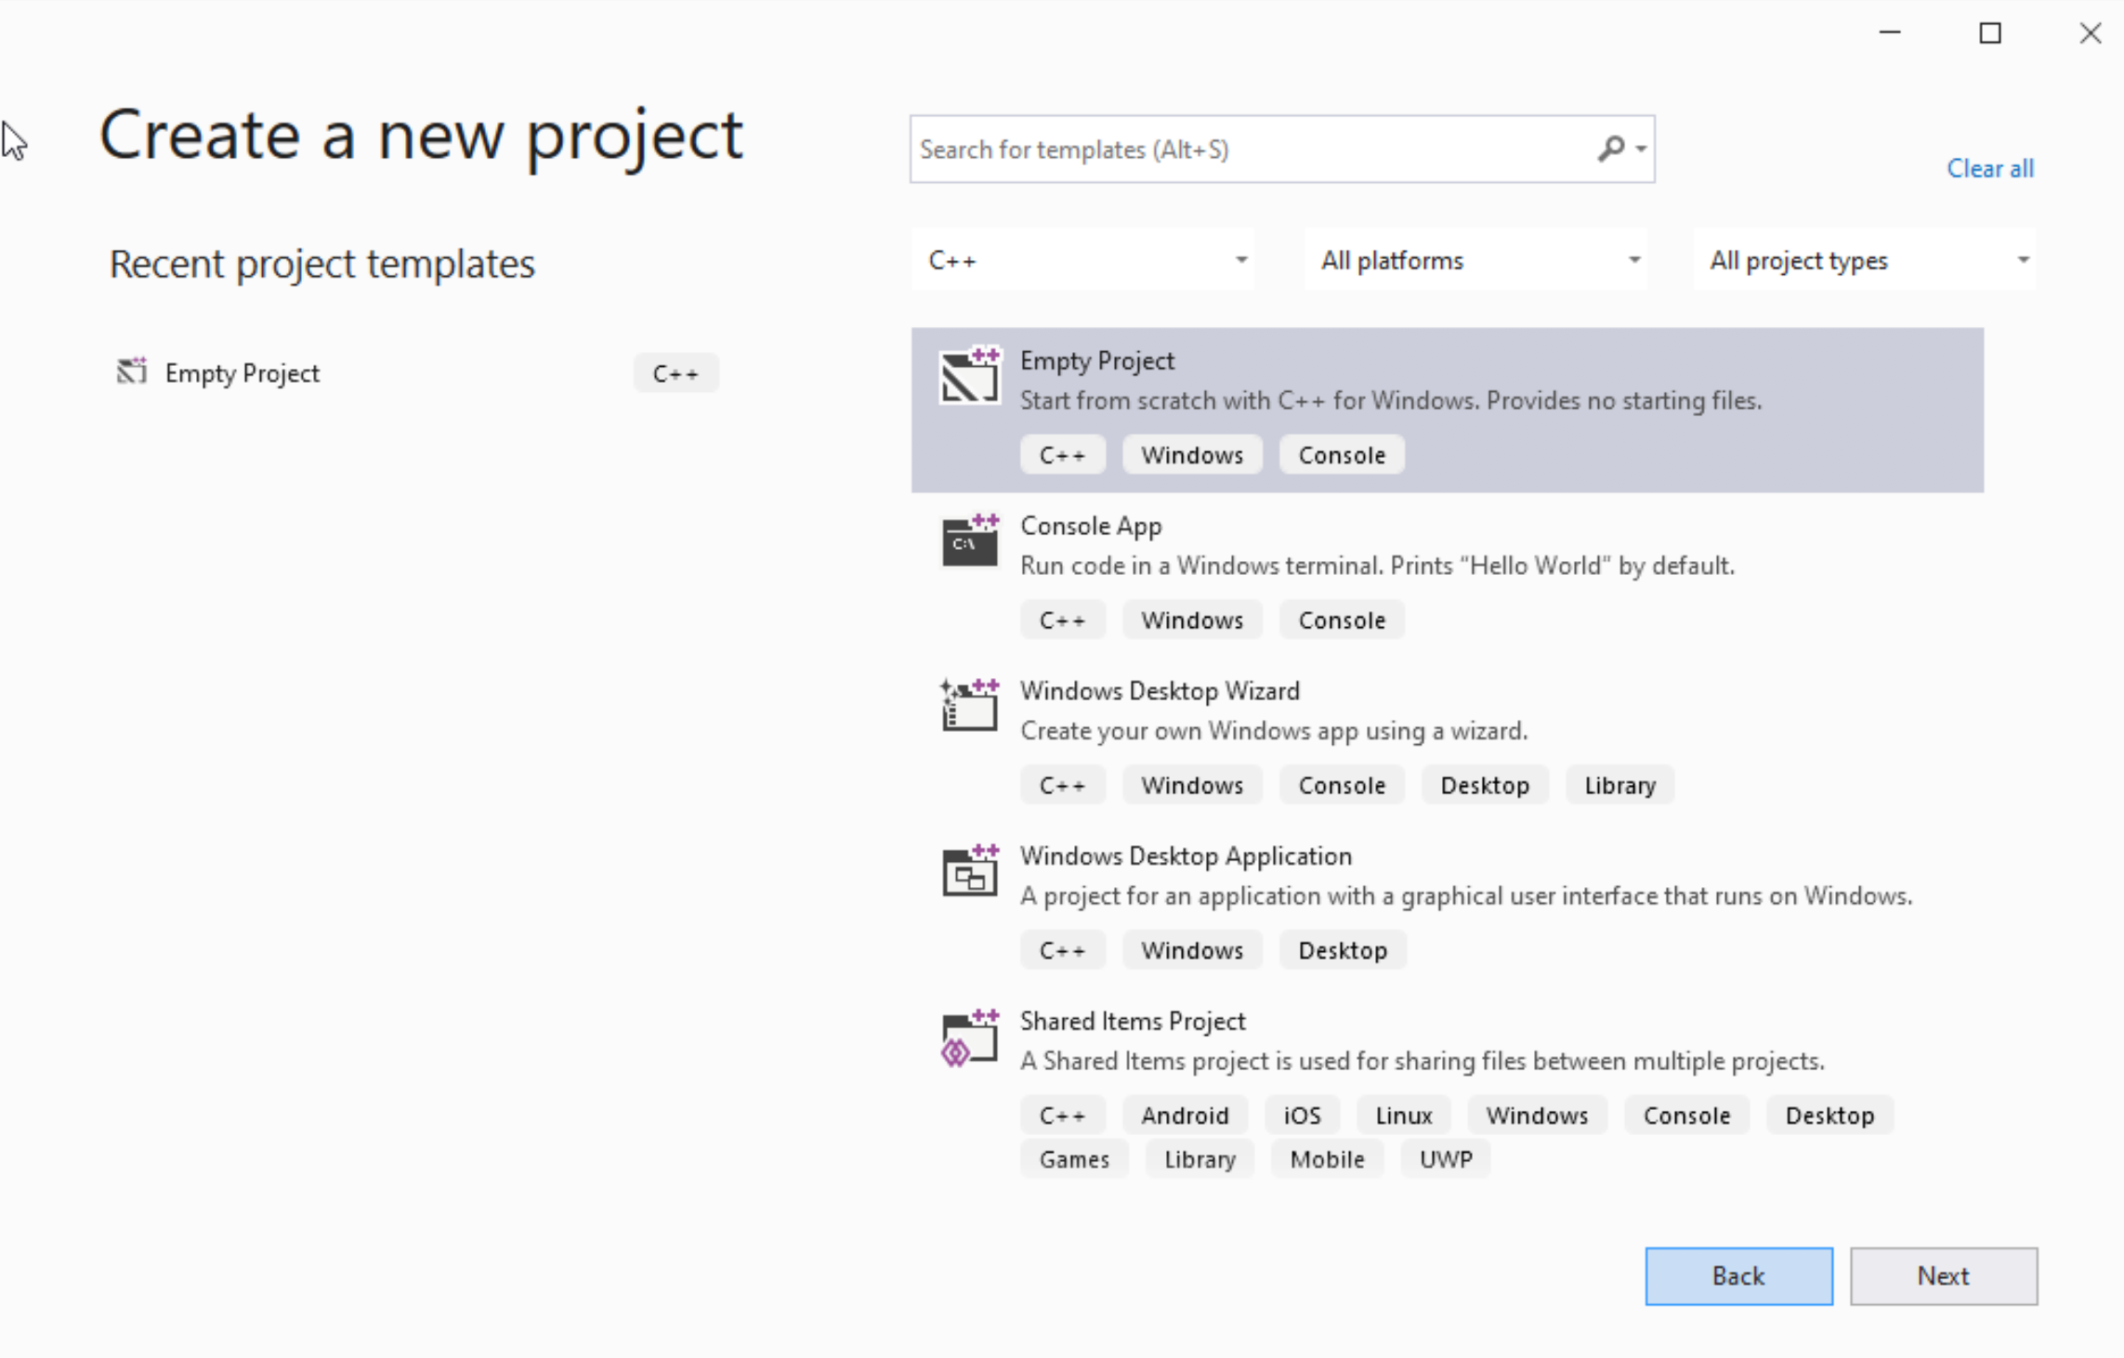




Create a new Project
Select C++ as language
Select Empty Project
Click Next

Slide 7
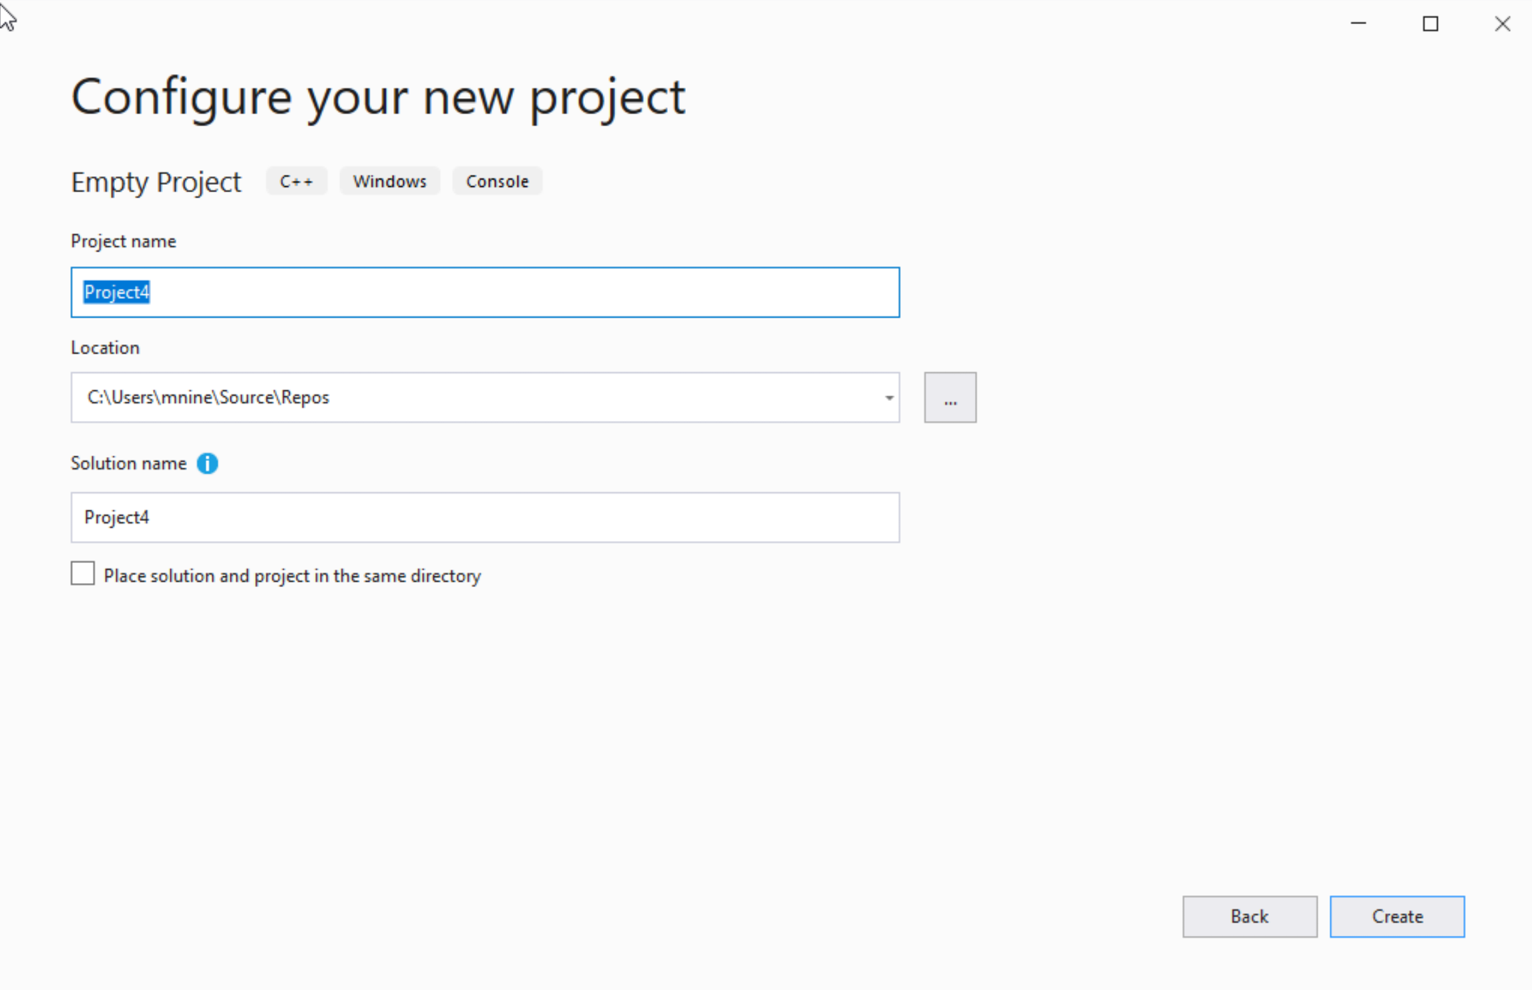

Create a new Project
You can change the project
name as you like
Also you can change the
project location
Click Next

Slide 8
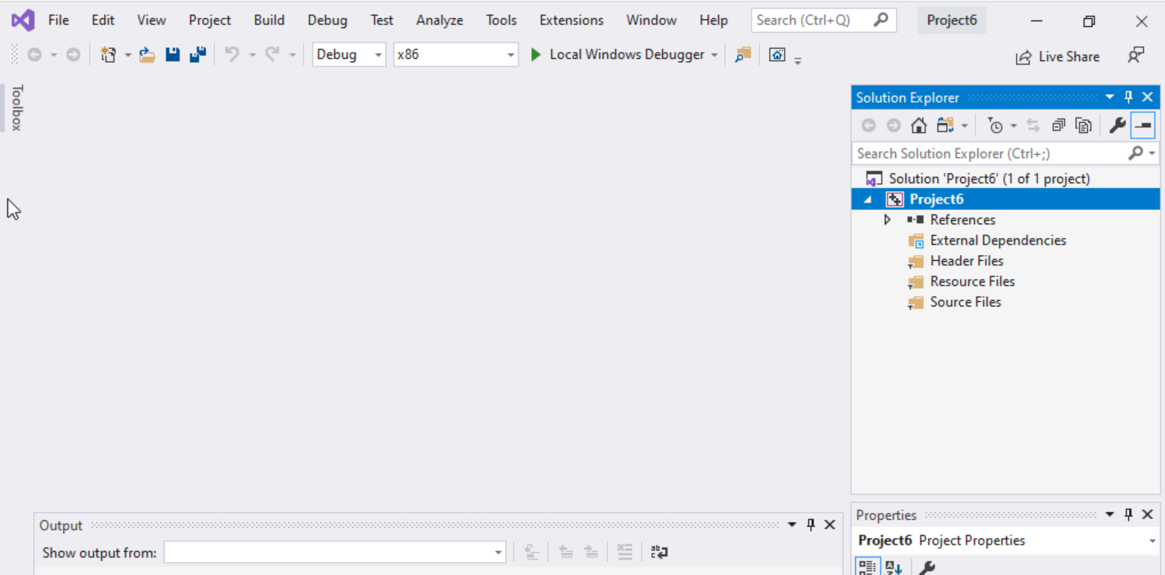
Create a new Project
Delete the
Following folders:
Header files
Resources Files, and
Source Files

Slide 9
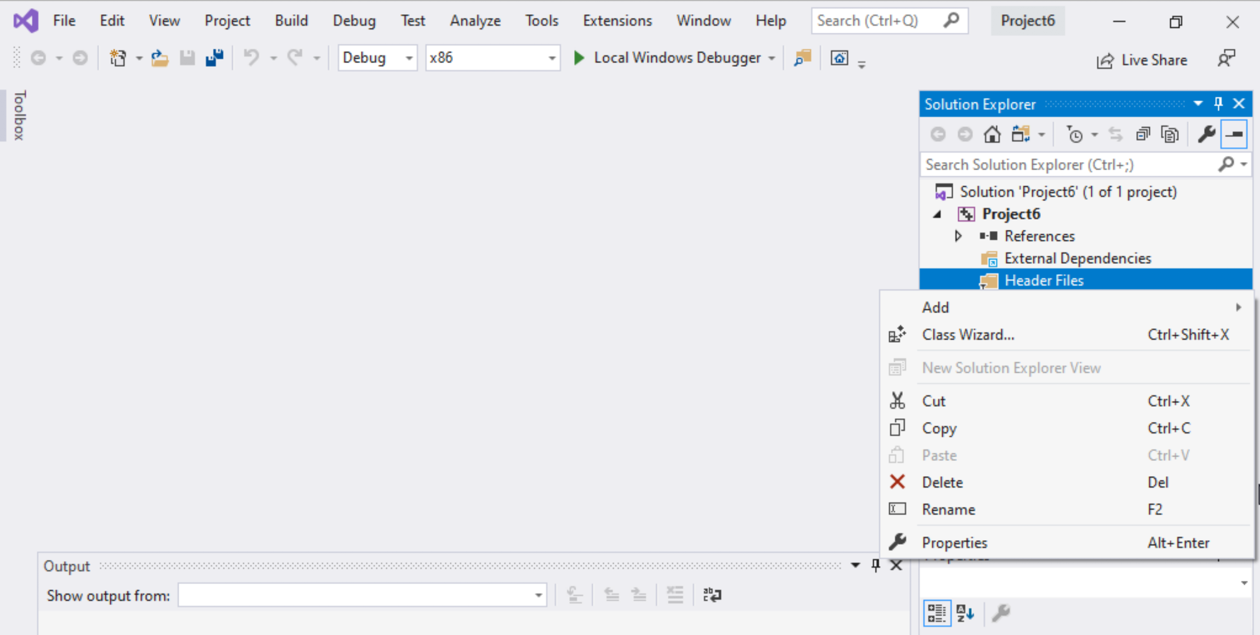
Create a new Project
To delete :
Select the folders
Right click on it
Select delete

Slide 10
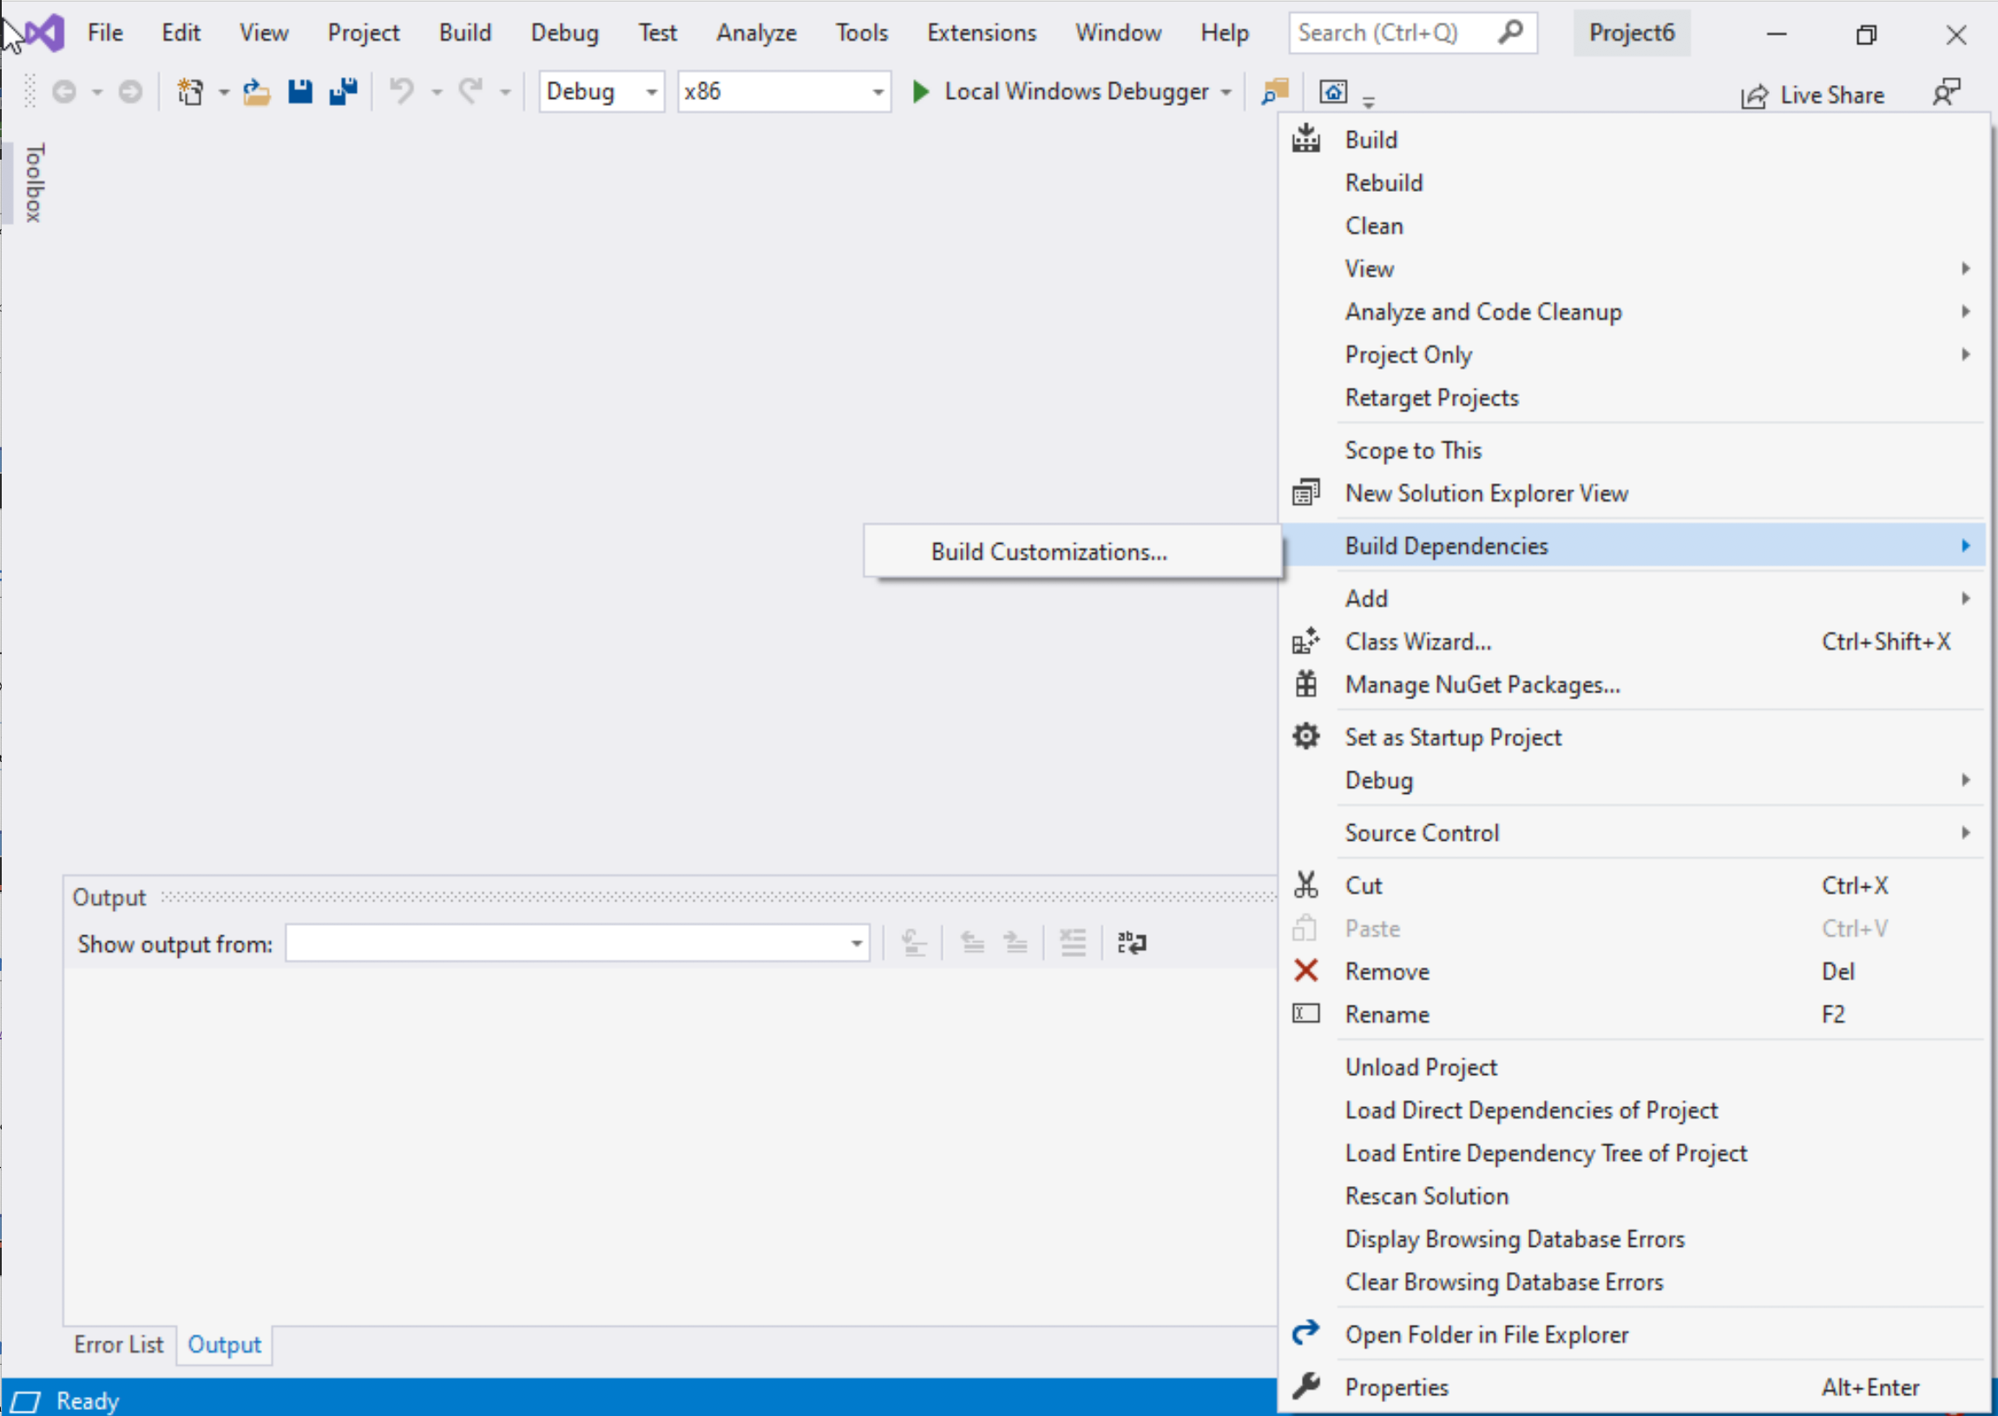
Create a new Project
Select Project Name on solution explorer
Right click on it
Go to Build Dependencies
Click on Build Customizations

Slide 11
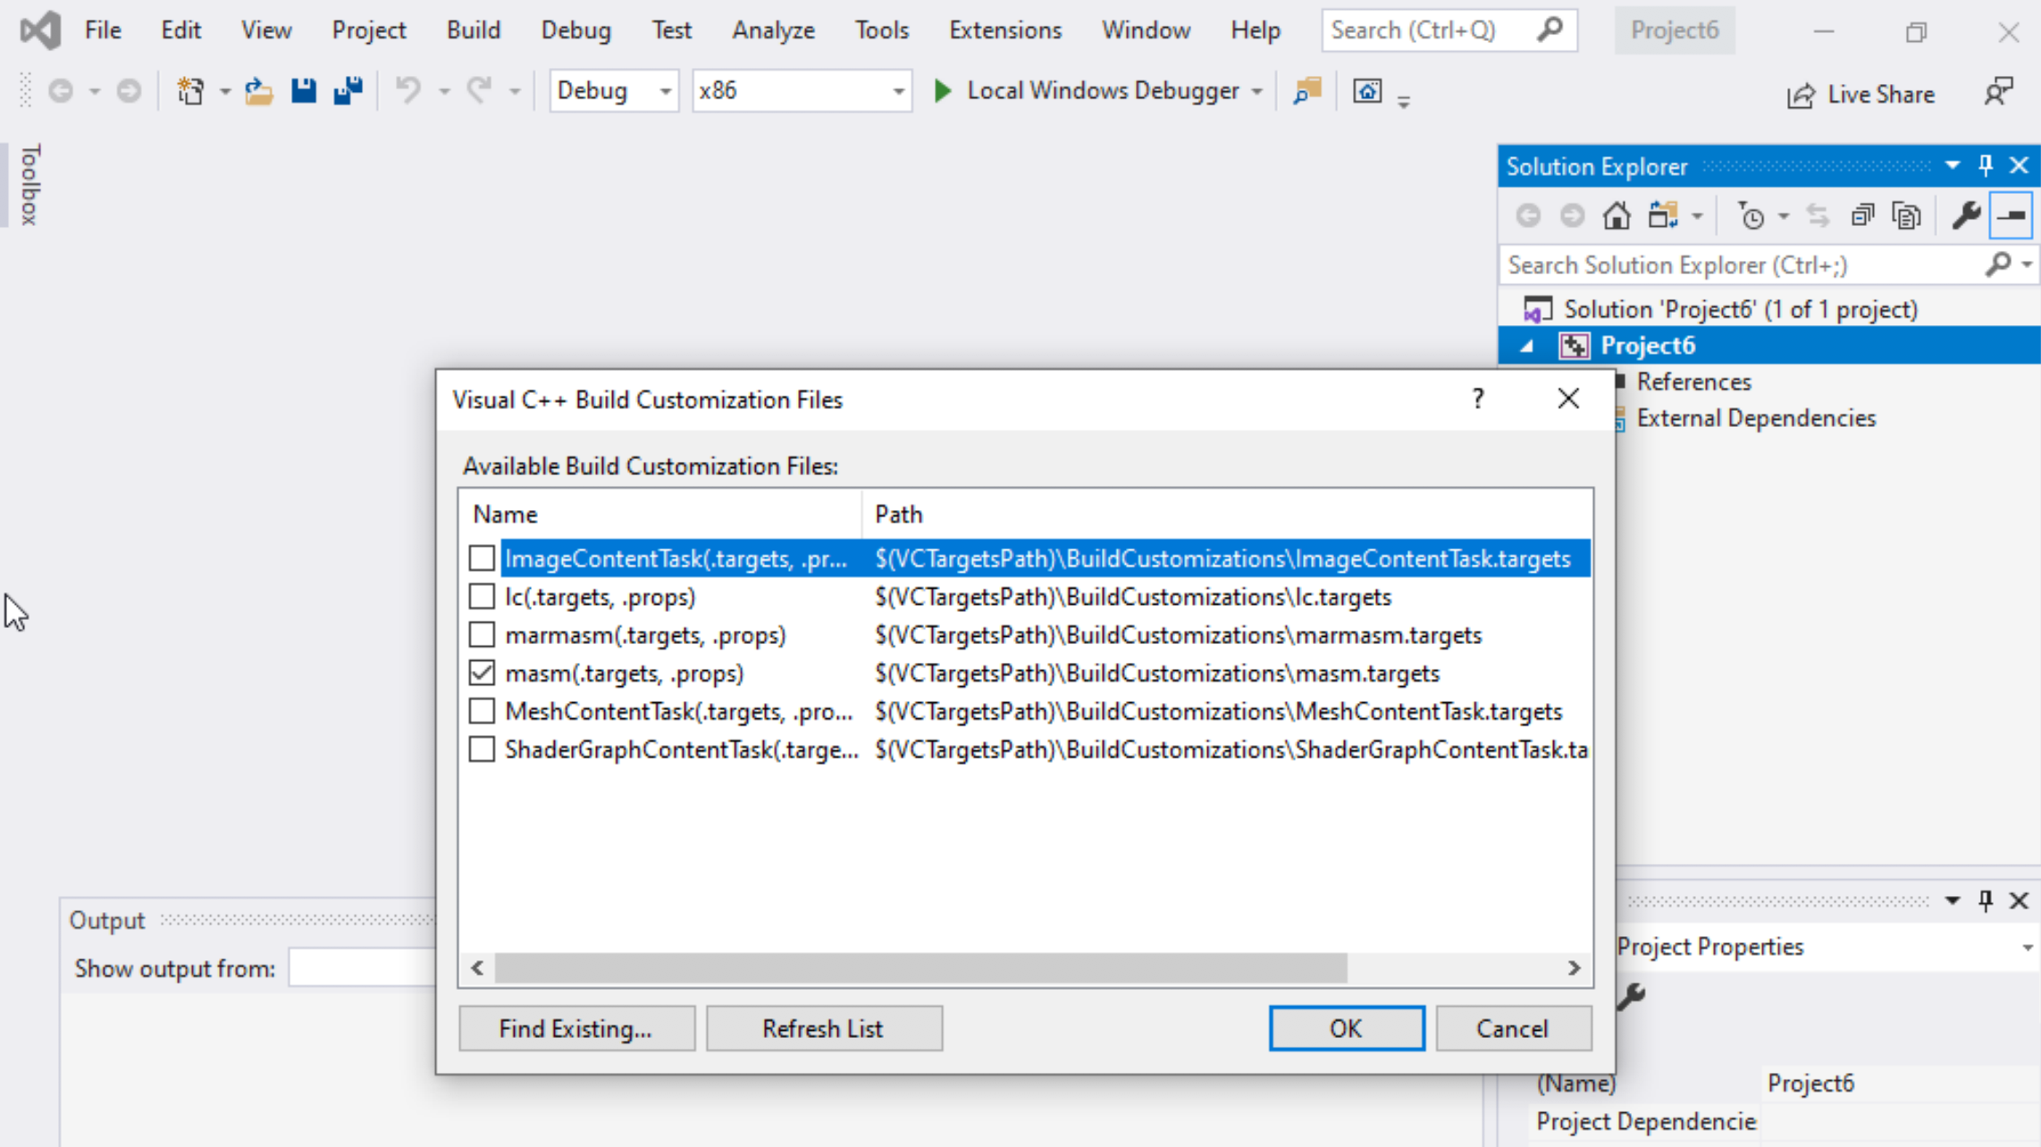
Create a new Project
Select mash(.target, .props)
Click ok

Slide 12
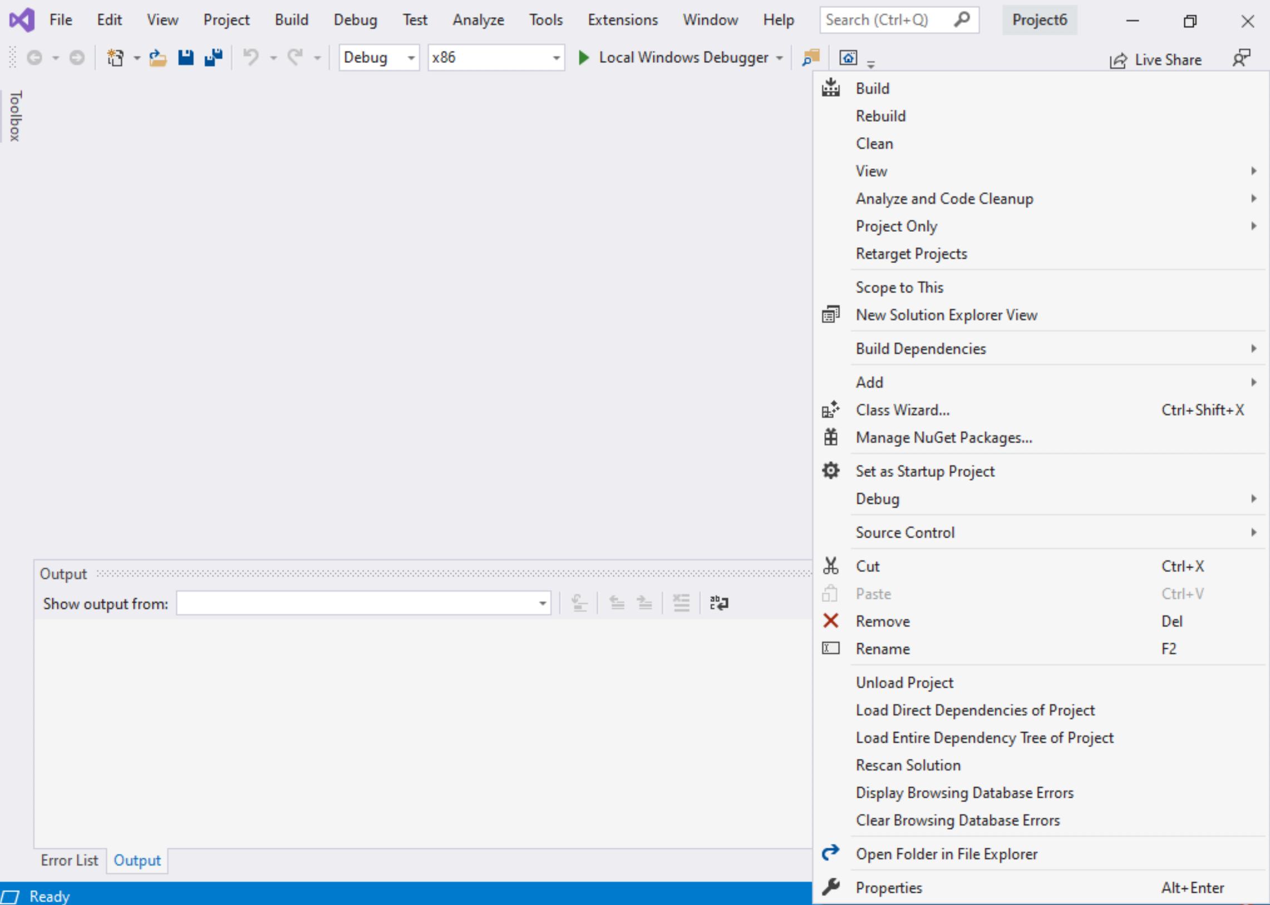
Create a new Project
Right click on the Project name in the solution explorer
Click properties

Slide 13
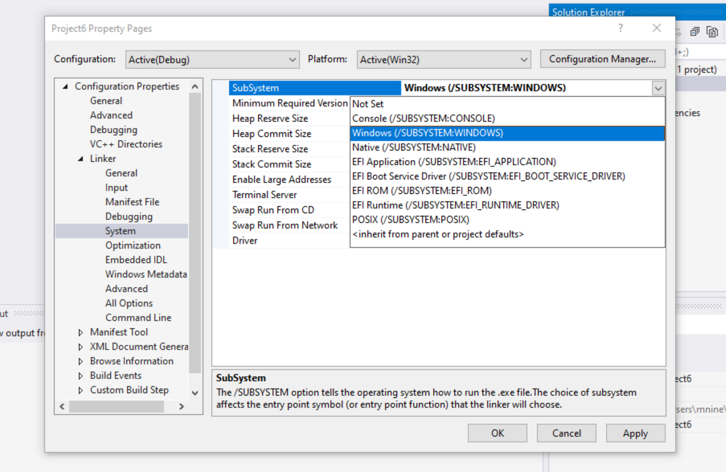

Create a new Project
Select Windows(/SUBSYSTEM:WINDOWS)
Click OK

Slide 14
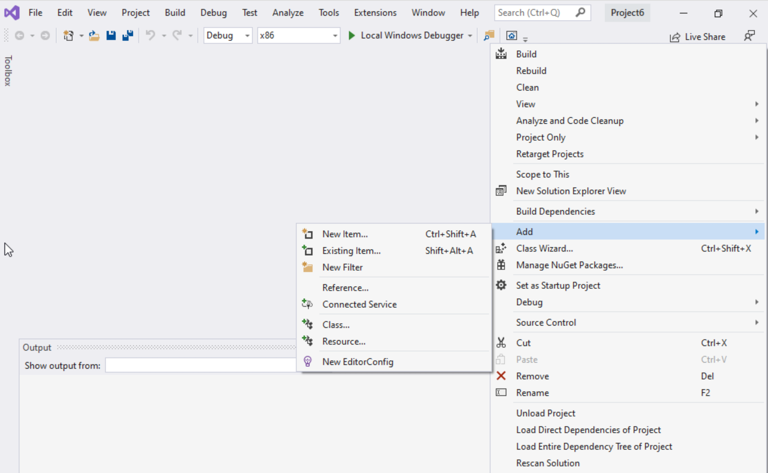
Create a new Project
Select Project name on solution explorer
Right click on it
Expand Add
Choose New Item

Slide 15
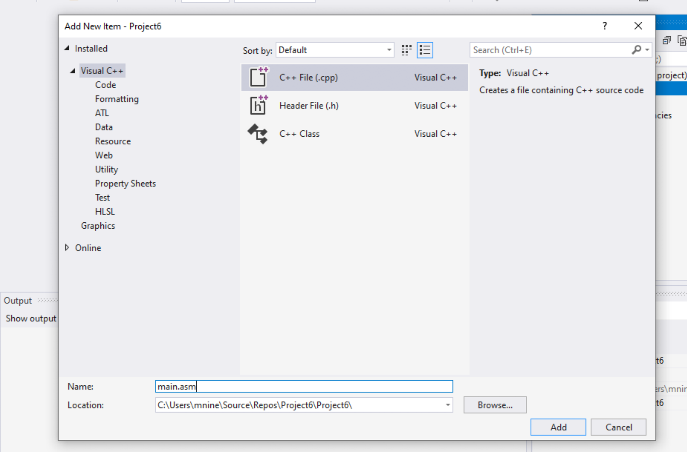


Create a new Project
Select C++ File(.cpp)
Name: main.asm
Click Add

Slide 16
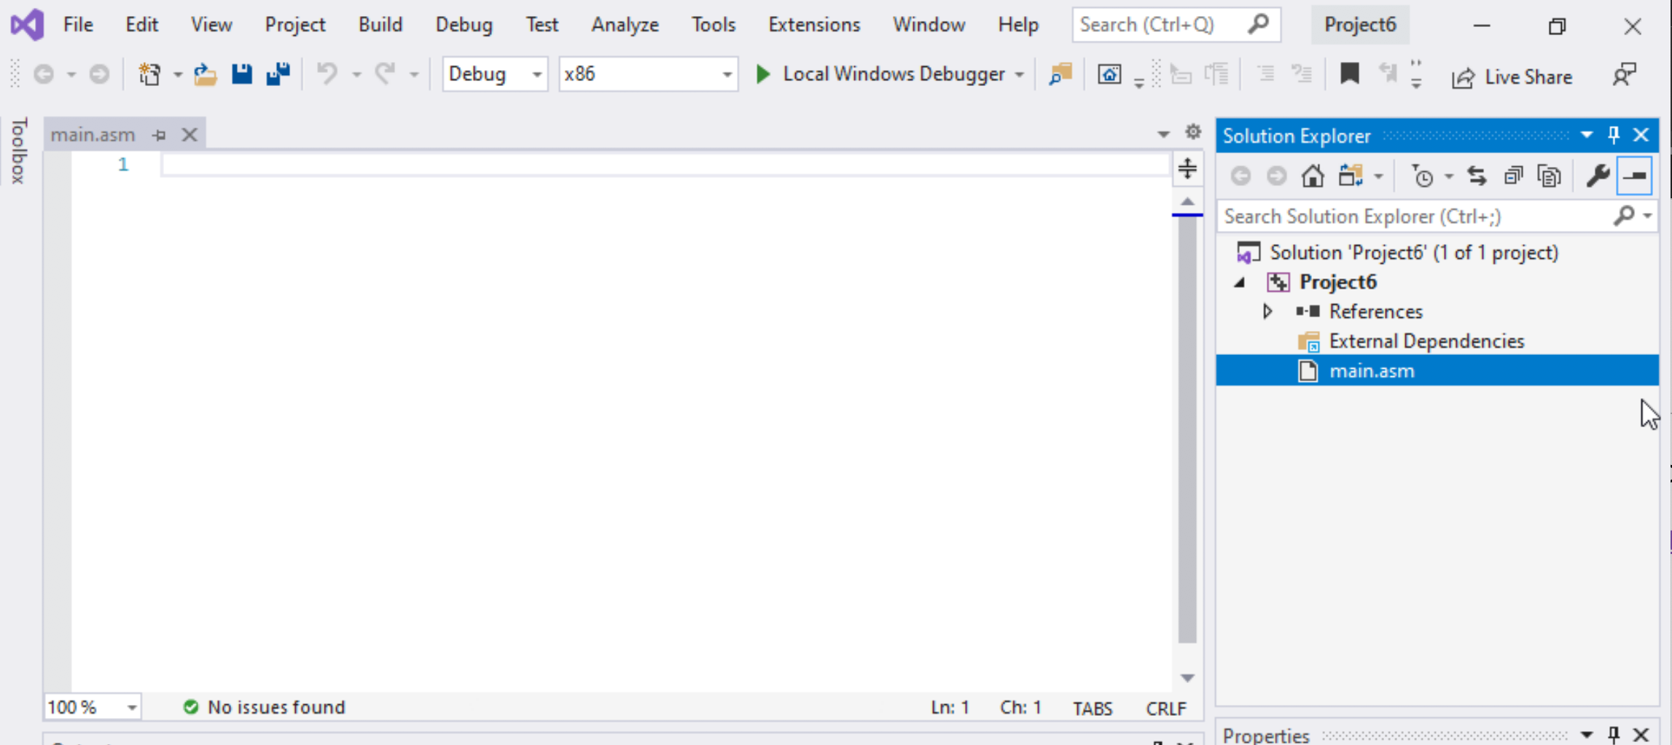

Create a new Project
Select main.asm
Add your code
In the main.asm File.

Slide 17
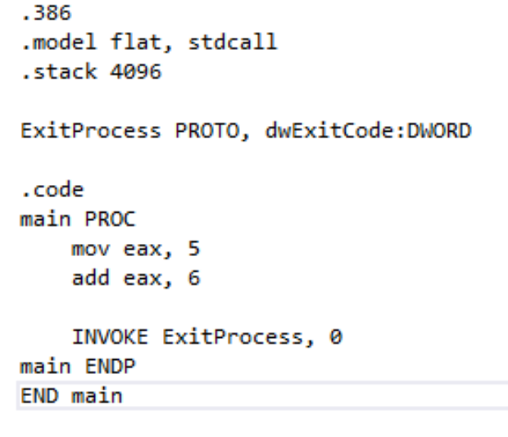
Sample Code
Type the sample code in the main.asm

Slide 18
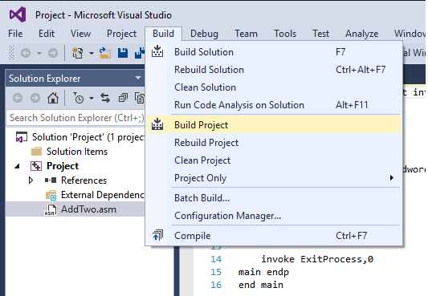
Run the code
Select Build Project (this will assemble and link your program) from the Build menu.
This will assemble and link your program

Slide 19
Run the code
You should see messages like the following, indicating the build progress:
Note: if you see 1 failed or more, then there must be at least one error that needs to be corrected

Slide 20
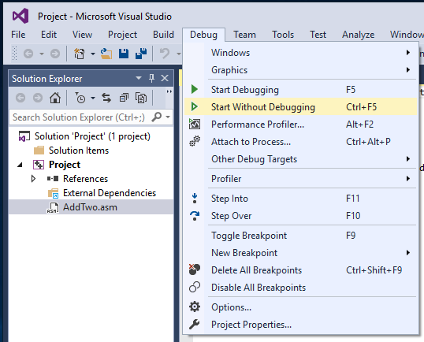
Run the code
Run the Program by selecting Start without Debugging from the Debug menu.
Press any keyto end running
- You will not see the result as the result is in a register
- See next slide

Slide 21
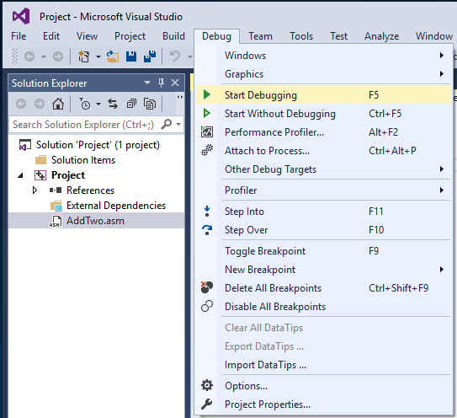
Debug the code
Select Start Debugging from the Debug menu.

Slide 22
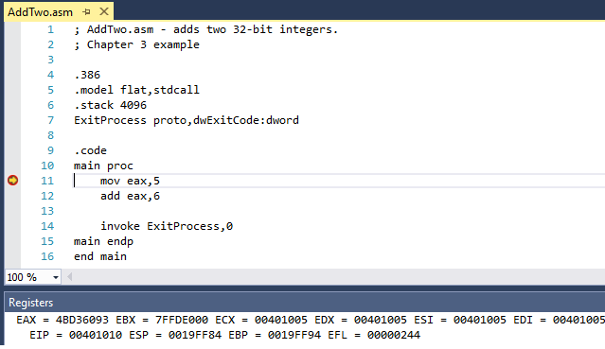
Debug the code
You should see the register window in the bottom:

Slide 23
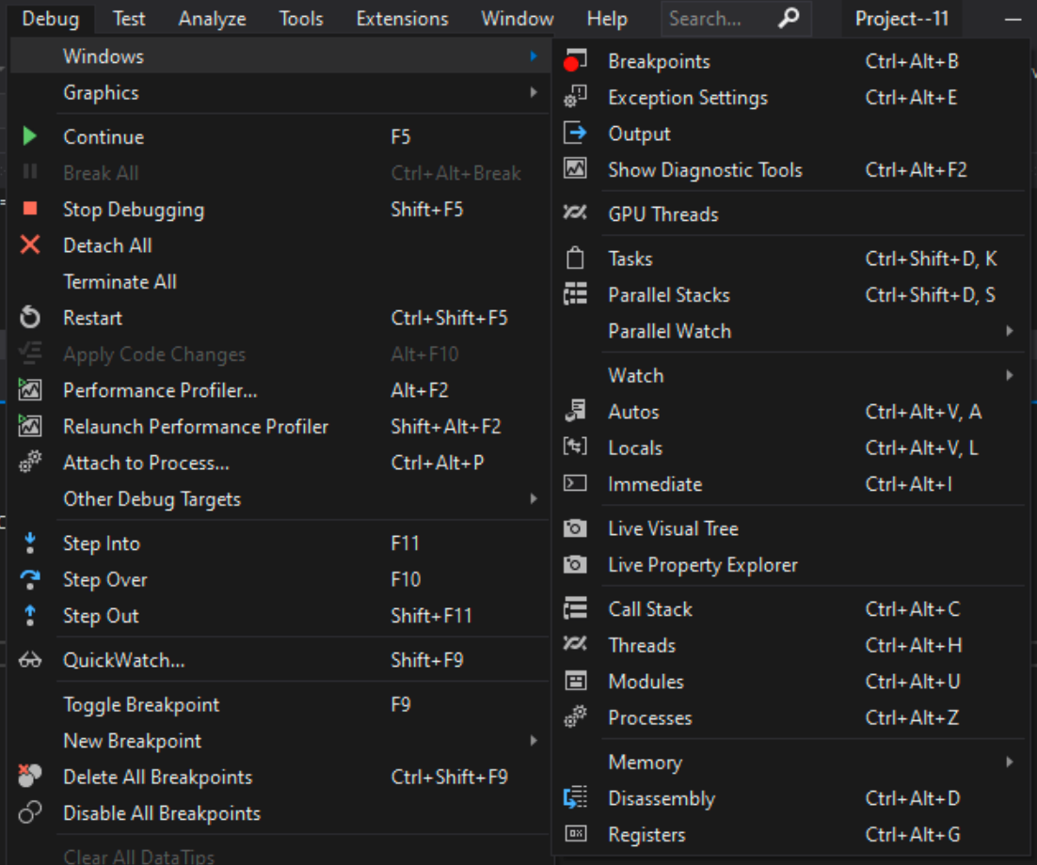

Debug the code
IF you don’t see the register window
Go to
Debug->Windows->Registers

Slide 24
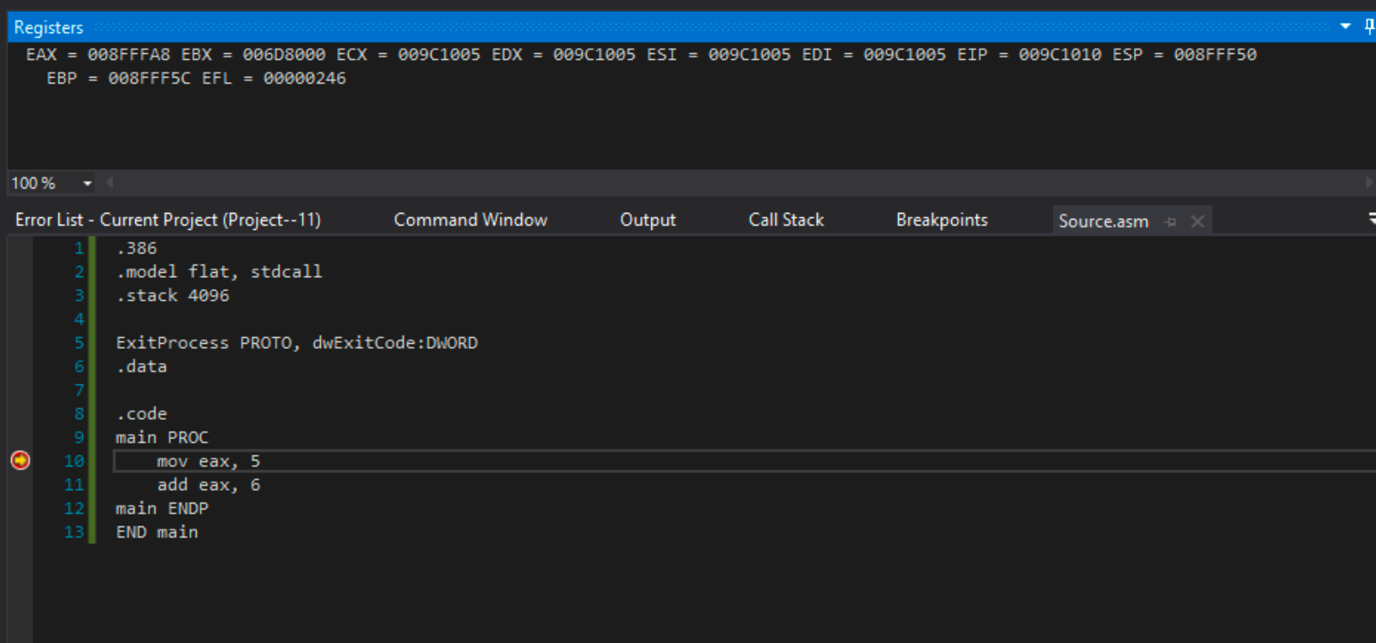
Debug the code
The register window should appear during the debugging

Slide 25
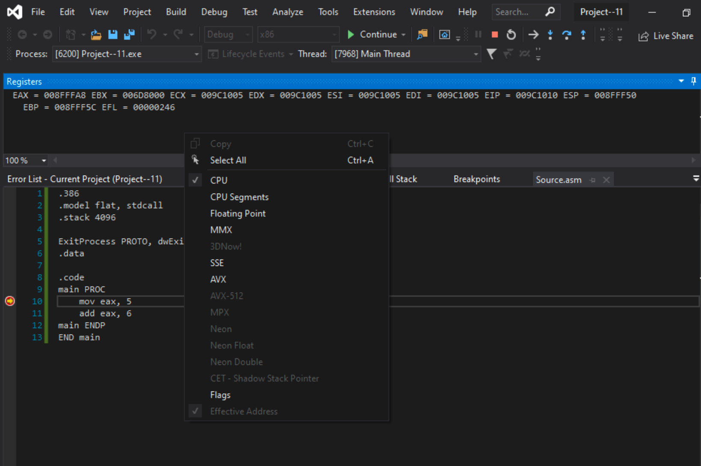
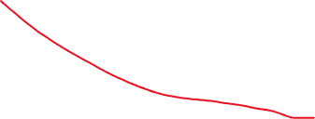
Debug the code
To see the EFLAGs
Right click on the register window and select “Flags”

Slide 26
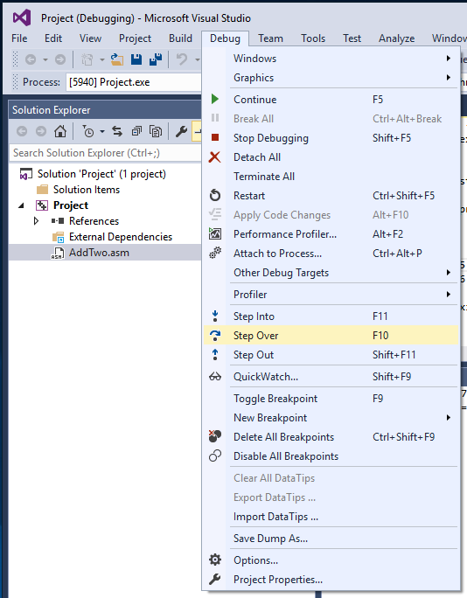
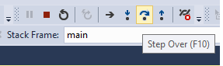
Debug the code
Select Step Over from the Debug menu.
Depending on how Visual Studio was configured,
Either the Fn+F10 function key or the Shift+F8 keys will execute the Step Over command.
You can also use the button to stepover:
After you reach the “invoke ExistProcess,0”,
Do not hit step over

Slide 27
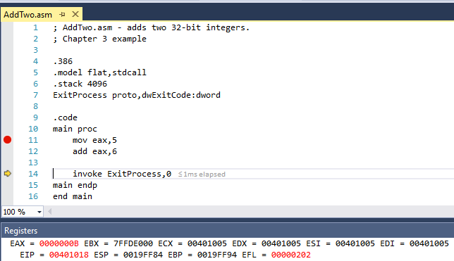
Debug the code
After you reach the “invoke ExistProcess,0”
Look at the eax register content and verify that its content is 11 (Which is B?).

Slide 28
Debug the code
When you hit step over, the program will end, as there is nothing to execute after:
“invoke ExistProcess,0”

Slide 29
Debug the code
Another way to start a debugging session is
set a breakpoint on a program statement by clicking the mouse in the vertical gray bar just to the left of the code window.
A large red dot will mark the breakpoint location.
Then you can run the program by selecting Start Debugging from the Debug menu.
If you try to set a breakpoint on a non-executable line, Visual Studio will just move the breakpoint forward to the next executable line when you run the program.

Slide 30
Some Practice Problems
Don’t need to turn-in these problems

Slide 31
Examples
What is the Most significant bit of the following binary number?
1000011010
Solution: 1

Slide 32
Examples
What is the minimum number of binary bits to represent a decimal number 435644?
Solution:
Convert the decimal number to binary: 1101010010110111100
Count the number of bits: 19

Slide 33
Examples
What is the minimum number of binary bits to represent the hexadecimal number 6A445?
Solution :
Convert the Hexadecimal number to binary:
0110 1010 0100 0100 0101
(2) Drop any leading zeros from the left side of the number:
110 1010 0100 0100 0101
(3) Count the number of bits: 19 bits

Slide 34
Examples
What is the 8-bit binary representation of the following decimal number?
- 43
Solution:
Convert 43 into binary : 101011
Make the number 8-bit by adding 2 leading zeros: 0010 1011
Perform 2’s complement on 0010 1011
(3.1) Flip the bits: 1101 0100
(3.2) add 1 to it: 1101 0100 + 1 = 1101 0101

Slide 35
Examples
Perform the following hexadecimal subtraction using 2’s complement.
A15F – 6ABC
Solution:
(1)Compute the 2’s complement of 6ABC:
(1.1) Reverse all the digits (subtract each digit from 15)
15 15 15 15
(-) 6 A B C
9 5 4 3

Slide 36

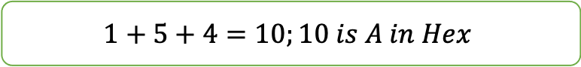
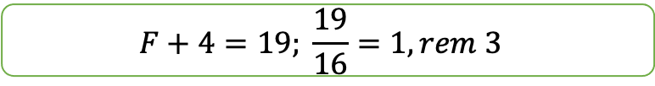


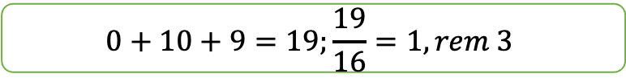

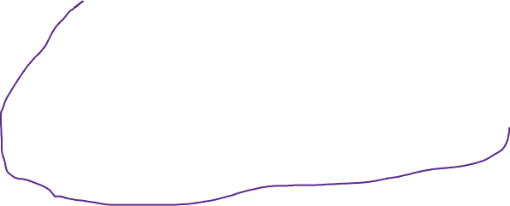
Examples
(1.2) add 1 to it: 9543+1 = 9544
Add A15F + 9544
Carry:1 0 0 1
A 1 5 F
9 5 4 4
3 6 A 3
Ignore the last carry.
$$F+4=19; \frac{19}{16}=1, rem 3$$
$$1+5+4=10;10 is A in Hex$$
$$0+10+9=19;\frac{19}{16}=1, rem 3$$

Slide 37
Examples
What is the decimal representation of following signed numbers?
10110111
Solution: MSB is 1, so the number is negative
Perform a 2’s complement: 1011 0111
(1.1) flip the bits : 0100 1000
(1.2) add 2 to it: 0100 1000 + 1 = 0100 1001
(2) Convert the number into decimal: 73
(3) Sign bit was 1, so the number is -73

Slide 38
Examples
How many selector bits required for a four input multiplexer?
Solution:
A multiplexer uses selector bits to select specific input and let that input available to the output.
When a multiplexer has two inputs, it can enumerate the inputs as 0 and 1.
When a multiplexer has 4 inputs, it needs two bits to enumerate them.
Selector bits - 00 – input 1
01 – input 2
10 – input 3
11 – input 4

Slide 39
Lab 2(b)
Submit these Math Problems to iCollege

Slide 40
Lab 2(b) : Submission
Solve the Problems provided in slide 41 to 42.
You can do your work in a text editor (Microsoft word, open office, etc.)
Or you can do it in a piece of paper, then scan or take a picture of the paper.
Convert them into pdf and submit in the icollege.

Slide 41
Lab 2(b) Problem 1
Design a 8-bit full adder. Draw the block diagram. [Hint: Lecture]

Slide 42
Lab 2(b) Problem 2
Draw the circuit for the following Boolean expression:
P = (X and Y) or (not X or Z) [Hint: Lecture]

Slide 43
Registers and Memory
A review

Slide 44
Registers
Registers are storage locations inside the processor.
A register can be accessed more quickly than a memory location (Why?).
Different registers serve different purposes.
Some of them are described below:
1
2
4
3

Slide 45
General-Purpose Registers (8 registers)
There are eight general purpose registers
EAX –
All major calculations take place in EAX,
making it similar to a dedicated accumulator register.
EDX –
The data register is the an extension to the accumulator.
It is most useful for storing data related to the accumulator's current calculation.

Slide 46
General-Purpose Registers
There are eight general purpose registers
ECX –
Like the variable i in high-level languages, the count register is the universal loop counter.
EBX –
In 16-bit mode, the base register was useful as a pointer.
Now, it is completely free for extra storage space.

Slide 47
General-Purpose Registers
There are eight general purpose registers
ESP –
ESP is the sacred stack pointer.
With the important PUSH, POP, CALL, and RET instructions requiring it's value,
there is never a good reason to use the stack pointer for anything else.
EBP –
In functions that store parameters or variables on the stack,
the base pointer holds the location of the current stack frame.
In other situations, however, EBP is a free data-storage register.

Slide 48
General-Purpose Registers
There are eight general purpose registers
EDI –
Every loop must store its result somewhere,
and the destination index points to that place.
ESI –
In loops that process data,
the source index holds the location of the input data stream.

Slide 49
General-Purpose Registers
Accessing Parts of Registers

Slide 50
General-Purpose Registers
Bits are stored in any registers right to left
Ex: 32-bit Register (referring to bits storage not bytes)
Left
Right

Slide 51
General-Purpose Registers
Bytes are stored right to left too
31
0
Byte4 | Byte3 | Byte2 | Byte1
Byte4
Byte3
Byte2
Byte1
A2B1C3D4h

Slide 52
Segment Registers
There are six segment registers
CS – code segment: hold program instructions
DS – data segment: hold variables
SS – stack segment: holds local function variables and function parameters.
ES, FS, GS - additional segments: can be used in a similar way as the other segment registers.

Slide 53
Instruction Pointer Register
EIP – instruction pointer (also called program counter):
contains the address of the next instruction to be executed .
It is also known as PC (Program Counter)

Slide 54
EFLAGS Register
EFLAGS- a register consists of individual binary bits that
control the operation of the CPU or
reflect the outcome of some CPU operation.
Thus, we have status and control flags
Each flag is a single binary bit

Slide 55
EFLAGS Register
Status flags record certain information about the most recent arithmetic or logical operation.
Carry
unsigned arithmetic out of range
Overflow
signed arithmetic out of range
Sign
result is negative
Zero
result is zero
A flag is set when it equals 1;
it is clear (or reset) when it equals 0.
Note: Control flags are out of the scope of this class

Slide 56
Some Practice Examples
Don’t need to turn-in these problems

Slide 57
Practice Problems
1. Which flag is set when the result of an unsigned arithmetic operation is too large to fit into the destination?
2. Which flag is set when the result of a signed arithmetic operation is either too large or too small to fit into the destination?
3. Which flag is set when an arithmetic or logical operation generates a negative result?

Slide 58
Practice Examples
4. Show the EDX register and the size and position of the DH, DL, and DX within it.

Slide 59
Lab 2(c)
Submit these Problems

Slide 60
Lab 2(c) : Submission
Solve the Problems provided in slide 61 to 62.
You can do your work in a text editor (Microsoft word, open office, etc.)
Or you can do it in a piece of paper, then scan or take a picture of the paper.
Convert them into pdf and submit in the iCollege.

Slide 61
Lab 2(c) Problems
2. Store the following value in EAX register: 12784569h
31
0
4 bytes

Slide 62
Lab 2(c) Problems
6. For each add instruction in this exercise, assume that EAX contains the given contents before the instruction is executed.
Give the contents of EAX as well as the values of the CF, OF, SF, ZF after the instruction is executed.
All numbers are in hex. (Hint: add eax, 40 will add 40 to the contents of register eax and stores the result back in eax)
Contents of EAX (Before) | Instruction | Contents of EAX (After) | CF | OF | SF | ZF
00000040 | add eax, 40
FFFFFF40 | add eax, 40
00000040 | add eax, -40
Assume that numbers are signed integers

